Slide 1


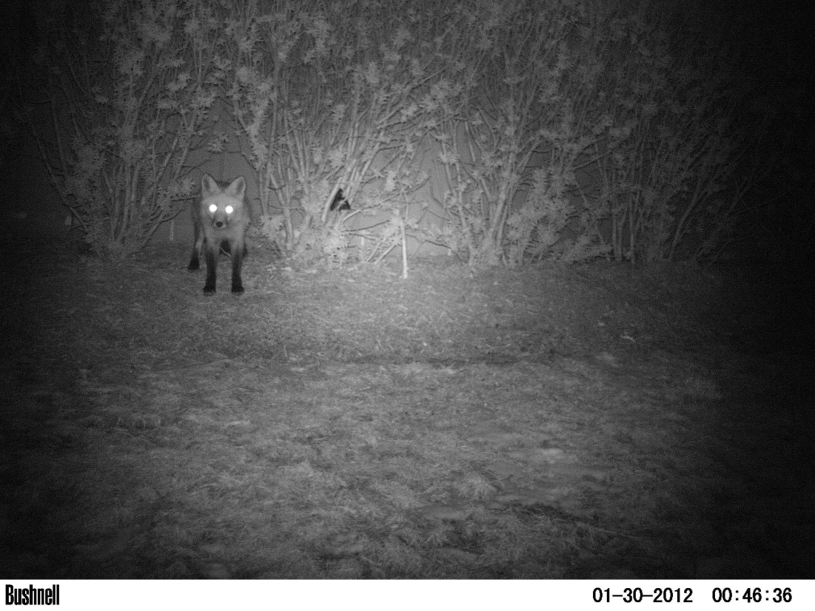
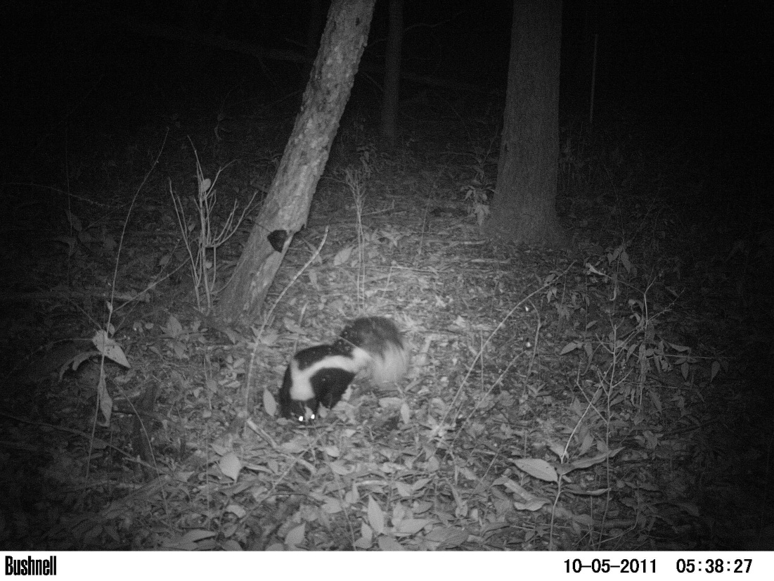
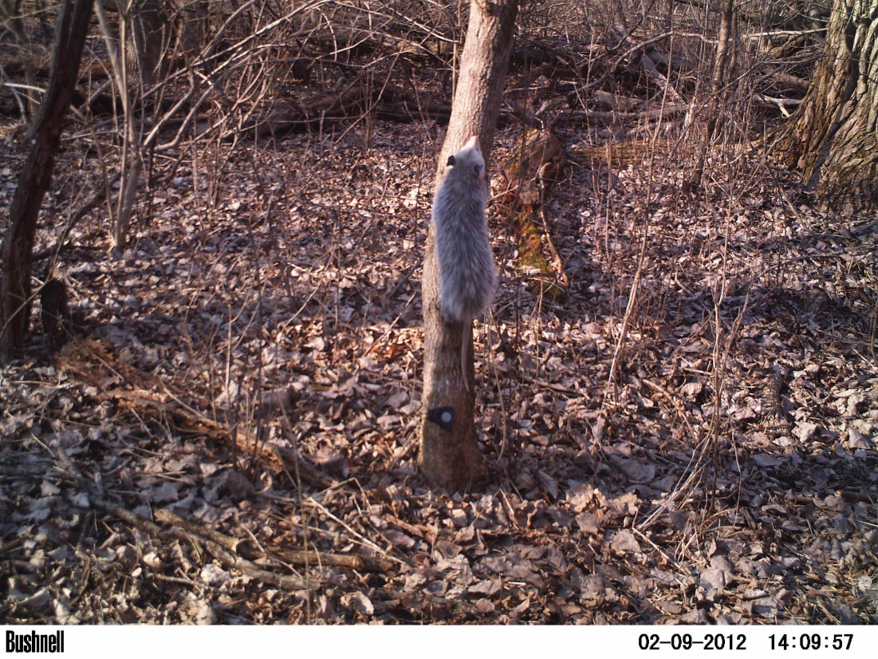
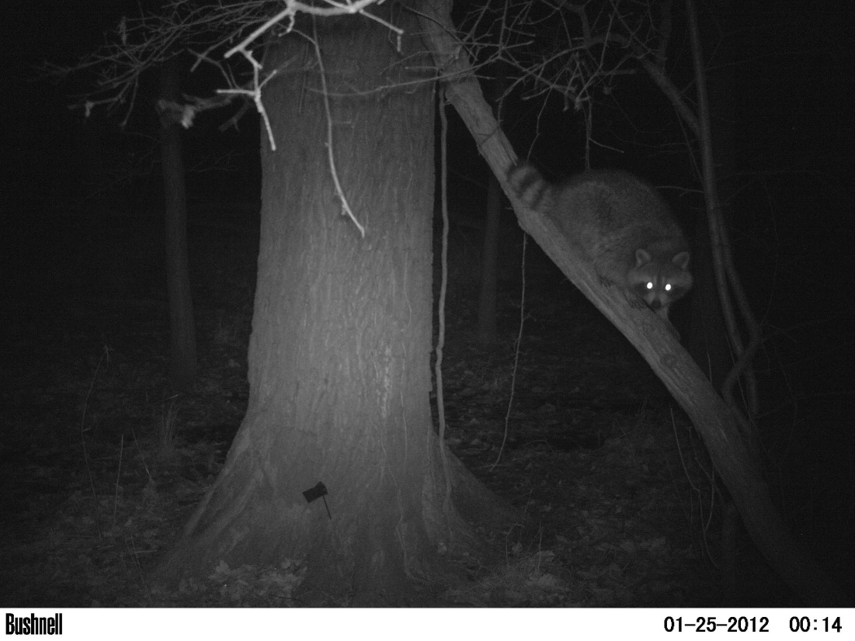
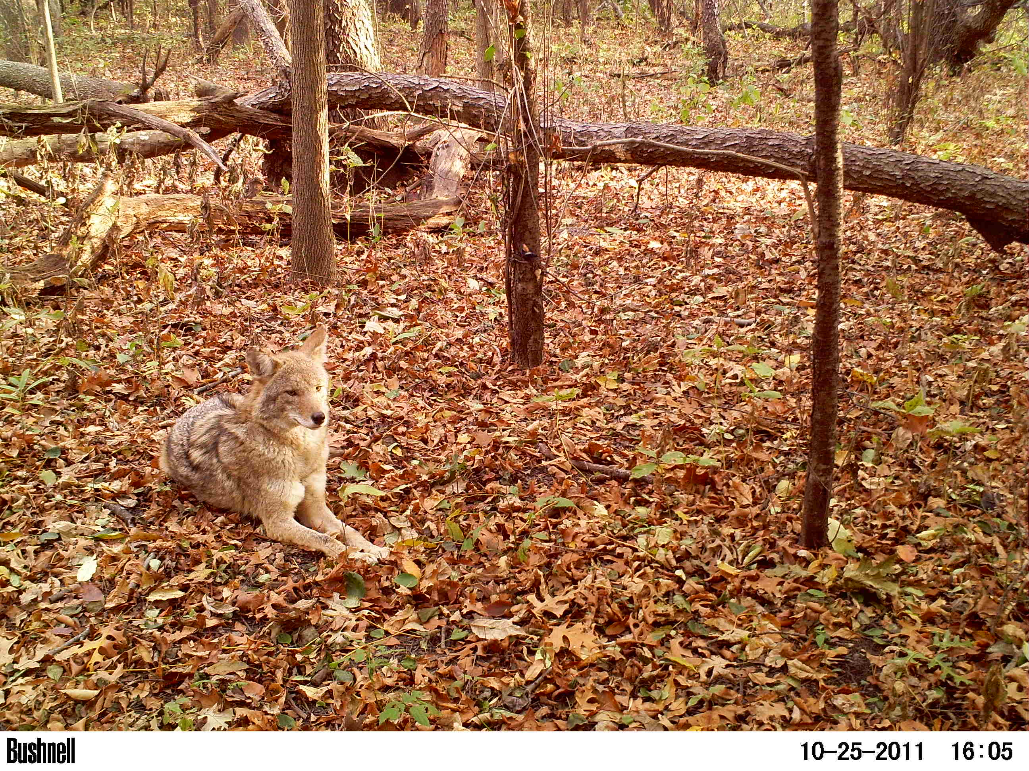
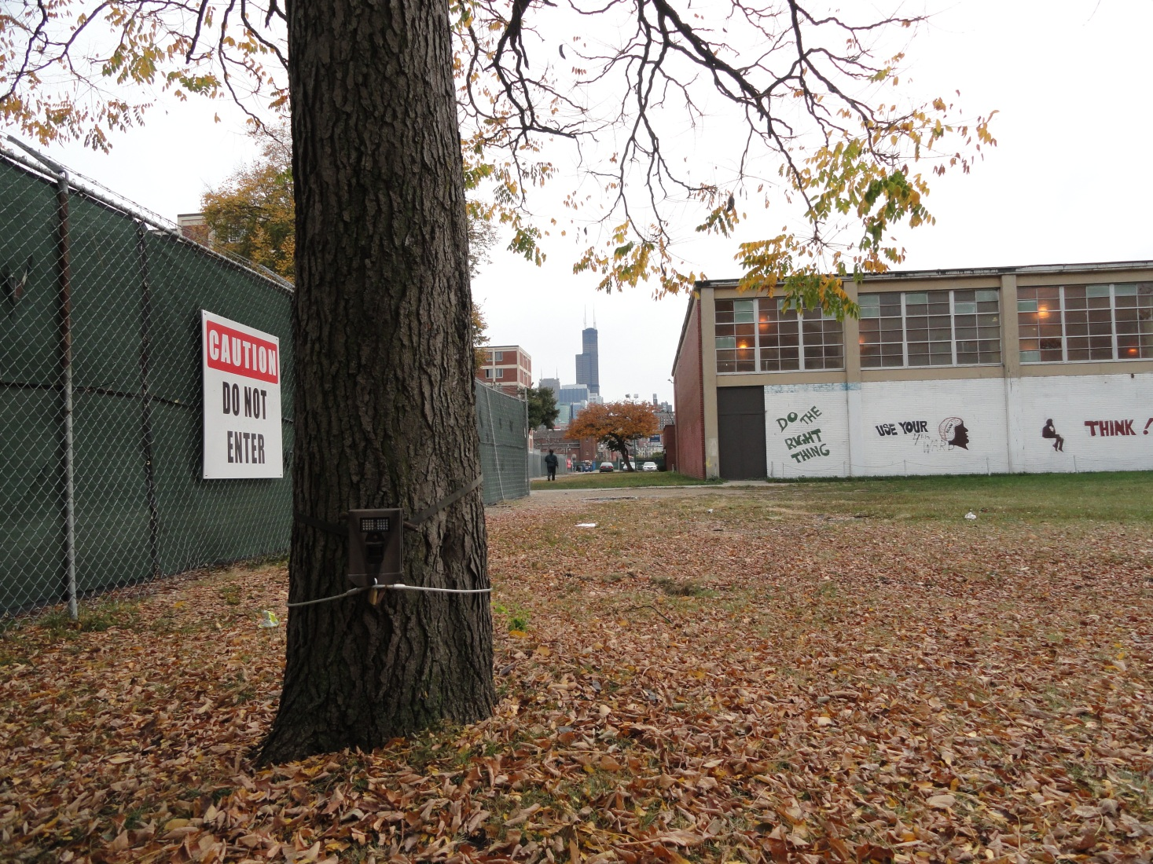
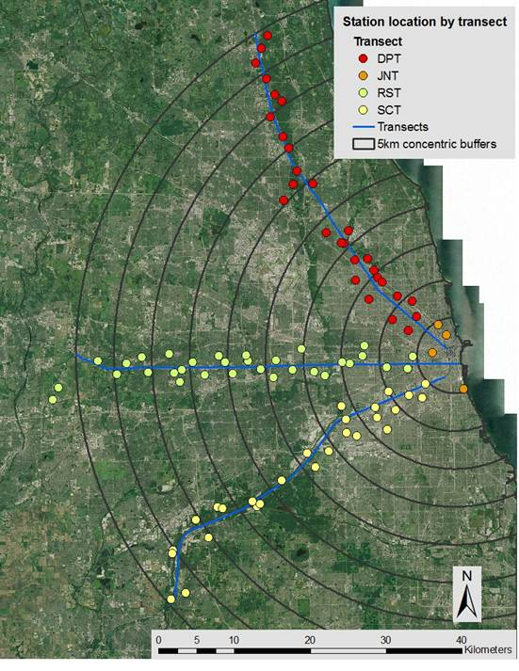
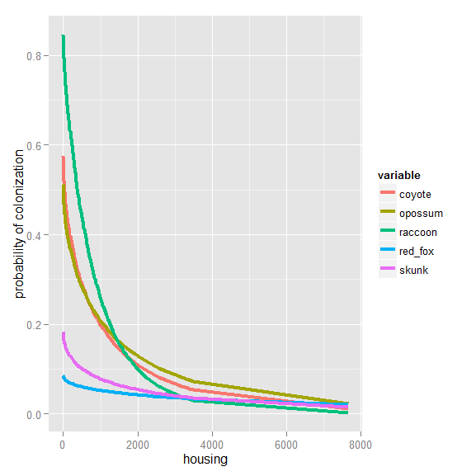






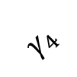


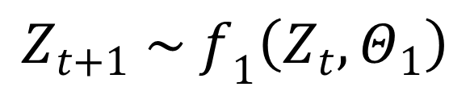








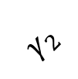
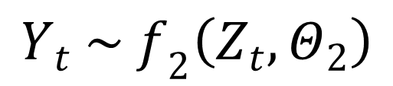
Developing a dynamic multi-species patch occupancy model
to study Chicagoland mesocarnivores
Joseph L. Simonis¹, Mason Fidino², Liza W. Lehrer², and Seth B. Magle²
Alexander Center for Applied Population Biology¹ and Urban Wildlife Institutie², Lincoln Park Zoo, Chicago, IL
Motivation
Chicagoland Mesocarnivore Guild
We would like to assess wildlife dynamics in urban landscapes
Camera traps are often used to study wildlife populations in urban landscapes, but have a nuanced sampling process: incomplete sampling, variable sampling effort across sites, unmarked individuals, etc.
Urban ecology is dynamic and understudied: the landscape is changing (urbanization), human-wildlife interactions, available habitat is patchily distributed but the matrix is permeable, there are relevant temporal dynamics at multiple scales (phenology, seasonality, invasion waves)
GOAL: Build a flexible, robust modeling framework that captures the complexity and variation in methods and ecology
We highlight the model using a camera trap survey of the mesocarnivores of Chicagoland:
Red Fox Skunk Opossum Raccoon Coyote
Model Application
Model
We developed a Bayesian state-space model, wherein a Markov Process describes a latent state (species presence at a given site at a given time) that is only partially observed:
Spring
$$Φ_{1}$$
Summer
$$Φ_{2}$$
Fall
$$Φ_{3}$$
Winter
$$Φ_{4}$$
Spring
$$ψ_{1}$$
$${1−Φ}_{1}$$
$${1−Φ}_{2}$$
$${1−Φ}_{3}$$
$${1−Φ}_{4}$$
$${1−ψ}_{1}$$
$$γ_{1}$$
$$γ_{2}$$
$$γ_{3}$$
$$γ_{4}$$
$${1−γ}_{1}$$
$${1−γ}_{2}$$
$${1−γ}_{3}$$
$${1−γ}_{4}$$
$$Z_{t+1} \sim f_{1}\left(Z_{t}, Θ_{1}\right)$$
$$Y_{t} \sim f_{2}\left(Z_{t}, Θ_{2}\right)$$
Acknowledgments
We thank numerous interns and colleagues for their assistance with field work. We are grateful to the many private landowners who granted us access to their property. This research was funded by the Lincoln Park Zoo and XXXXXXXX
Notes:
Comments/Instructions:
No color backgrounds, no photo backgrounds
Headers should all remain in Sentence Case
Use bullet points or brief sentences as desired to create more white space and improve readability
To highlight a certain area, you can make an optional colored text box – grey
Text should be fully justified
Use photos, graphs, maps, and diagrams to make poster more dynamic; color choice is at your own discretion

